Slide 1
Chapter 2 Lesson 2-2
Histograms , Frequency polygons and Ogives

Slide 2
The number of counties, divisions, or parishes for each of
the 50 states is given below. Use the data to construct
a grouped frequency distribution with 6 classes, a
histogram, a frequency polygon, and an ogive. Analyze
the distribution.
67 27 15 75 58 64 8 67 159 5
102 44 92 99 105 120 64 16 23 14
83 87 82 114 56 93 16 10 21 33
62 100 53 88 77 36 67 5 46 66
95 254 29 14 95 39 55 72 23 3

Slide 3
Range = 254- 3 = 251
Width = 251 / 6 = 41.8 ≈ 42

Slide 4
Class limits | Class boundaries | Class Mid point | Frequency
3-44 | 2.5-44.5 | 23.5 | 19
45-86 | 44.5-86.5 | 65.5 | 17
87-128 | 86.5-128.5 | 107.5 | 12
129-170 | 128.5-170.5 | 149.5 | 1
171-212 | 170.5-212.5 | 191.5 | 0
213-254 | 212.5-254.5 | 233.5 | 1
Total |  |  | 50

Slide 5
Frequency
20
HISTOGRAM
18
16
14
12
10
8
6
4
2
2.5
44.5
86.5
128.5
170.5
212.5
Class boundaries

Slide 6
Frequency
20
FREQUENCY POLYGON
18
16
14
12
10
8
6
4
2
23.5
65.5
107.5
149.5
191.5
233.5
Class mid point

Slide 7
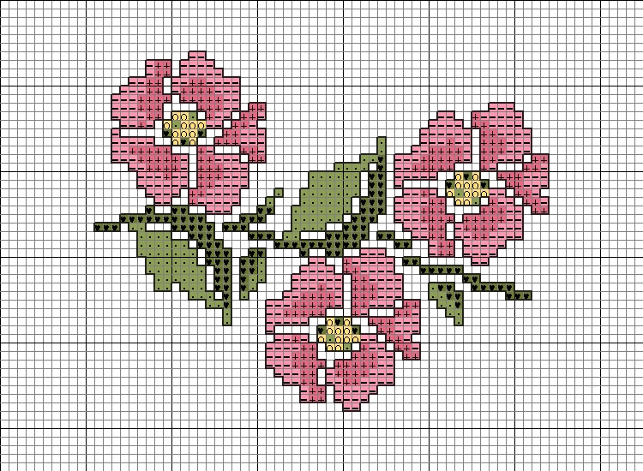
 | Cumulative frequency
Less than 2.5 | 0
Less than 44.5 | 19
Less than 86.5 | 36
Less than 128.5 | 48
Less than 170.5 | 49
Less than 212.5 | 49
Less than 254.5 | 50

Slide 8
OGIVE
Cumulative Frequency
50
50
50
45
45
45
40
40
40
35
35
35
30
30
30
25
25
25
20
20
20
15
15
15
10
10
10
5
5
5
Class boundaries
86.5
128.5
170.5
212.5
254.5
2.5
44.5

Slide 9
Relative Frequency Graphs

Slide 10
The amount of protein (in grams) for a variety of fast-food
sandwiches is reported here. Construct a frequency
distribution using 6 classes. Draw a histogram, a
frequency polygon, and an ogive for the data, using
relative frequencies. Describe the shape of the
histogram.
23 30 20 27 44 26 35 20 29 29
25 15 18 27 19 22 12 26 34 15
27 35 26 43 35 14 24 12 23 31
40 35 38 57 22 42 24 21 27 33

Slide 11
Range = 57-12=45
Width = 45/6=7.5
≈ 8

Slide 12
Class limits | Class boundaries | Class midpoints | Frequency | Relative frequency
12 - 19 | 11.5 - 19.5 | 15.5 | 7 | 7/40= 0.175
20 - 27 | 19.5 - 27.5 | 23.5 | 17 | 17/40 = 0.425
28 - 35 | 27.5 - 35.5 | 31.5 | 10 | 10/40 = 0.250
36 - 43 | 35.5 - 43.5 | 39.5 | 4 | 4/40= 0.100
44 - 51 | 43.5 - 51.5 | 47.5 | 1 | 0.025
52 - 59 | 51.5 - 59.5 | 55.5 | 1 | 0.025
Total |  |  | 40 | 1

Slide 13
Relative frequency
Histogram
0.45
0.40
0.35
0.30
0.25
0.20
0.15
0.10
0.5
11.5-19.5
19.5-27.5
27.5-35.5
35.5-43.5
43.5-51.5
51.5-59.5
Class boundaries

Slide 14
Frequency polygon
Relative frequency
0.45
0.40
0.35
0.30
0.25
0.20
0.15
0.10
0.5
15.5
23.5
31.5
39.5
47.5
55.5
Class midpoints

Slide 15
Cumulative relative Frequency
Less than 11.5 0.000
Less than 19.5 0.175
Less than 27.5 0.600
Less than 35.5 0.850
Less than 43.5 0.950
Less than 51.5 0.975
Less than 59.5 1.000

Slide 16
Ogive
crf
1.2
1.0
0.8
0.6
0.4
0.2
11.5-19.5
19.5-27.5
27.5-35.5
39.5
43.5-51.5
51.5-59.5
Boundaries

Slide 17
The histogram is positively skewed

